Slide 1

COMPREHENSIVE
MONITORING & LOGGING
WITH GRAFANA & PROMETHEUS

Slide 2
Introduction
Significance of effective monitoring, centralized logging & dashboards
Importance of Monitoring, Centralized Logging & Dashboards
Impact of proactive monitoring on system reliability and performance
Key Components : Grafana, Prometheus & Loki
Introduction, roles & popularity
AGENDA &
KEY ASPECTS
Setting Up Monitoring Stack
Steps involved, compatibility & architecture diagram
Data Collection & Visualization
Process and highlights of data source support
Querying Logs with Loki
Log aggregation, querying capabilities

Slide 3

Effective monitoring, centralized logging, and dashboards are essential for maintaining the reliability, security, and performance of IT systems. They empower organizations to respond proactively to issues, optimize resources, enhance security, and comply with regulatory requirements, ultimately contributing to better operational efficiency and user satisfaction.
Significance
Monitoring, Logging & Dashboards

Slide 4
Proactive Issue Detection and Resolution:
Monitoring: Effective monitoring allows you to track the health and performance of systems and
applications in real-time. It helps identify issues, anomalies, or potential failures before they impact users,
enabling proactive problem-solving.
Centralized Logging: Centralized logging aggregates logs from various sources, making it easier to detect
and troubleshoot issues across the entire infrastructure. It provides a unified view of logs,
reducing the time and effort required for diagnosis.
Dashboards: Dashboards provide a visual representation of key performance metrics and data.
They enable teams to quickly spot trends, abnormalities, and performance bottlenecks,
facilitating timely action.
Enhanced Security:
Monitoring: Monitoring can include security monitoring, which helps in identifying suspicious activities,
breaches, or vulnerabilities. It enables rapid response to security incidents and aids in safeguarding
sensitive data.
Centralized Logging: Centralized logs are valuable for security investigations. They provide a
comprehensive audit trail, making it easier to trace security incidents and analyze potential threats.
Dashboards: Dashboards can display security-related metrics and alerts,
allowing security teams to monitor and respond to security events effectively.

Slide 5
Capacity Planning:
Monitoring: Monitoring data assists in capacity planning by tracking resource utilization trends over time.
It helps organizations allocate resources efficiently and avoid unexpected capacity shortages.
Centralized Logging: Log data can reveal patterns of resource consumption and application behavior,
guiding capacity planning decisions.
Dashboards: Dashboards can display historical data trends, aiding in long-term capacity planning and infrastructure
scaling.
Efficient Troubleshooting:
Monitoring: Timely alerts and monitoring data simplify troubleshooting, reducing downtime and service disruptions.
Centralized Logging: Centralized logs streamline troubleshooting by providing a centralized repository of detailed
information for diagnosing issues.
Dashboards: Dashboards offer a quick overview of system health, making it easier to identify and address problems.

Slide 6
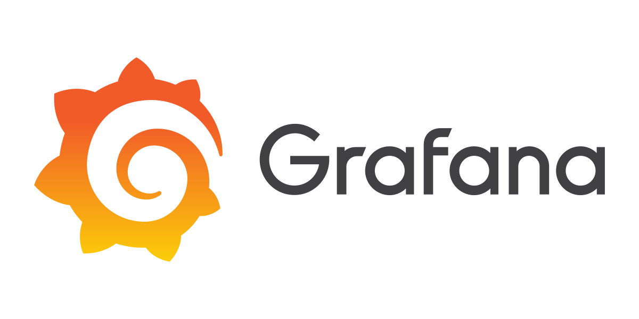
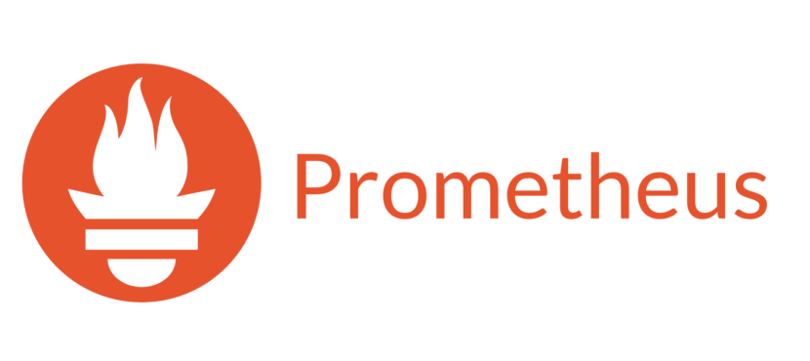




Key Components
The core components of our monitoring and logging stack, which together form the foundation of robust data insights.
Introduction to the building blocks
Grafana
Prometheus
Grafana Loki
The Dashboarding Powerhouse
The Monitoring Maestro
The Log Aggregator

Slide 7
GRAFANA
Grafana is an open-source interactive data-visualization platform, developed by Grafana Labs, which allows users to see their data via charts and graphs that are unified into one dashboard (or multiple dashboards) for easier interpretation and understanding. You can also query and set alerts on your information and metrics from wherever that information is stored, whether that’s traditional server environments, Kubernetes clusters, or various cloud services, etc. You’re then more easily able to analyze the data, identify trends and inconsistencies, and ultimately make your processes more efficient. Grafana was built on open principles and the belief that data should be accessible throughout an organization, not just to a small handful of people. This fosters a culture where data can be easily found and used by anyone who needs it, empowering teams to be more open, innovative, and collaborative.
DASHBOARDS
Grafana’s dashboards give a new level of meaning to data collected from various sources. Those dashboards can then be shared with other team members and other teams, allowing collaboration and more extensive exploration of the data and its implications. Build dashboards specifically for you and your team and customize your panels to create the visualizations you want, using advanced querying and transformation capabilities.

Slide 8
Key features
Panels: visualize your data any way you want using histograms, graphs, geomaps, heatmaps, etc.
Plugins: Render your data in real time on a user-friendly API via panel plugins that hook into existing data sources—no data migration required. You can also create data source plugins, retrieving metrics from any custom API.
Alerts: One user interface lets you create, consolidate, and control all your alerts.
Transformations: Rename, summarize, combine, and perform calculations across data sources and queries.
Annotations: Use rich events from different data sources to annotate graphs.
Panel Editor: A consistent user interface for configuring and customizing your panels.

Slide 9
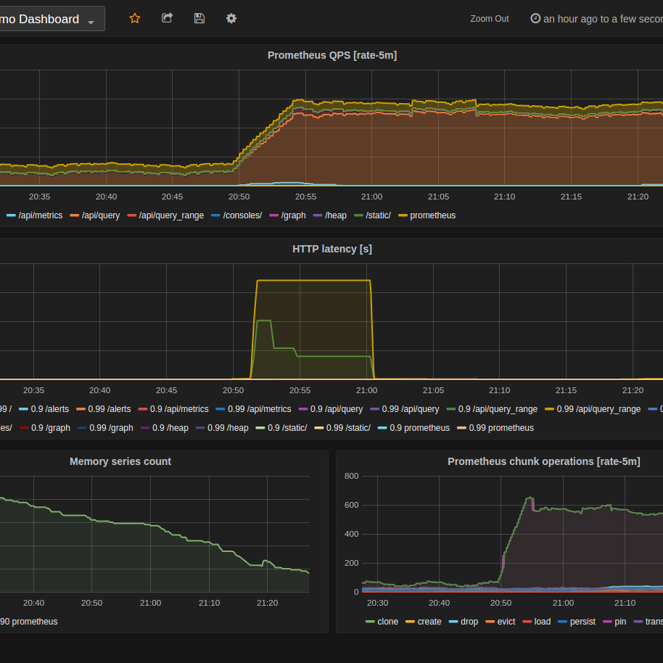
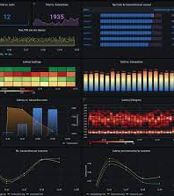
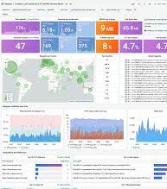
Some Grafana Dashboard Samples

Slide 10
Grafana offers different tiers or editions to cater to different use cases and requirements.
Grafana Open Source :- Centralize the analysis, visualization, and alerting for all of your data with Grafana. For users who prefer to set up, administer, and maintain their own installation.
Grafana Cloud :- Offered as a fully managed service, Grafana Cloud is the fastest way to adopt Grafana and includes a scalable, managed backend for metrics, logs, and traces.
Grafana Enterprise :- Grafana’s powerful visualization and alerting, enhanced with access to Enterprise data source plugins and built-in collaboration features. For organizations that have specific privacy or security requirements and need a self-managed environment.
For detailed comparison, kindly check the below URL :-
https://grafana.com/pricing/

Slide 11
PROMETHEUS
Prometheus is an open-source tool for monitoring and alerting for cloud-native systems, such as Kubernetes. It collects and stores metrics as time-series data, including a timestamp for each entry. Prometheus can also collect and record labels, which are optional key-value pairs.
Prometheus was originally built at SoundCloud in 2012. Since then, many companies and organizations have adopted Prometheus, and the project has a very active developer and user community.
Prometheus records metrics in a time series database built using an HTTP pull model. It has flexible queries and real-time alerting. Prometheus can discover targets dynamically and automatically scrap new targets on demand. Prometheus supports over ten languages and custom libraries are easy to implement.
Use cases of Prometheus
Application performance monitoring - Prometheus can be used to monitor the performance of applications using metrics such as response times, error rates, and resource utilization of different workflows.
Load testing - Prometheus can test infrastructure and applications under varying high loads using metrics like CPU and memory utilization and network traffic. This data can be used to optimize applications to be more scalable and efficient.
Infrastructure monitoring - Prometheus can monitor the health and performance of infrastructure components like servers and databases.

Slide 12
Key features of Prometheus
The robust and flexible query language called PromQL allows users to retrieve and process metrics
data in real-time.
A multi-dimensional data model includes time series data, which is distinguished by the name of the
metric and key/value pairs.
An HTTP pull model is used to retrieve time-series data, while an intermediary gateway is used to push data.
A range of visualization options, including a built-in web UI and integration with third-party tools
such as Grafana. The web UI lets users explore and visualize metrics data using a variety of chart types.
In the meantime, Grafana provides advanced visualization and dashboarding capabilities.
Individual server nodes can function independently since there is no dependency on distributed storage.
The discovery of targets is accomplished through service discovery or static configuration.

Slide 13
Grafana Loki
Grafana Loki is a log aggregation system that stores and queries logs from applications and infrastructure. It's a set of components that can be combined into a logging stack. Loki is designed to be cost-effective and easy to operate. It's inspired by Prometheus but focuses on logs instead of metrics. Loki is highly scalable and can handle petabytes of log data. It's also open source, so it's a low-cost log analytics solution.
Loki is different from other logging systems because it only indexes metadata about logs, such as labels. It doesn't index the contents of the logs. This makes it easier to operate and more scalable. To keep queries fast, Loki recommends keeping labels as minimal as possible.
Loki is the main server that stores logs and processes queries. Grafana is used to query and display the logs. It has the following key features:
Efficient memory usage: Loki indexes a set of labels, which can be significantly smaller than other log aggregation products.
Multi-tenancy: Multiple tenants can use a single Loki instance.
LogQL: Loki's query language.
Scalability: Loki is horizontally scalable.
Distributed architecture: Loki's architecture makes it an ideal tool for businesses of all sizes.
Cost-effectiveness: Loki is cost-effective because it only indexes metadata. It stores log data in highly compressed chunks and uses low-cost object storage.
Integration: Loki integrates with Prometheus, Grafana, and K8s.

Slide 14






Grafana, Loki, and Prometheus are commonly used together to create a comprehensive observability and monitoring stack. They work together to collect, store, analyze, and visualize data from various sources.
IMPLEMENTATION
Of monitoring stack

Slide 15
Data Collection:
Prometheus: Prometheus is primarily responsible for data collection. It scrapes metrics and time-series data from various sources, including applications, servers, databases, and more. It uses a pull-based model, where Prometheus servers periodically query endpoints (exposed by the services to be monitored) to collect metrics.
Data Storage and Querying:
Prometheus: Prometheus stores the collected metrics in its local time-series database. It offers a powerful querying language called PromQL, allowing users to retrieve and analyze data effectively. Prometheus has built-in support for data retention policies, so you can configure how long data is kept.
Centralized Logging:
Loki: While Prometheus is focused on metrics and time-series data, Loki specializes in log aggregation. It collects logs from various sources and centralizes them in a highly efficient manner. Loki uses a label-based indexing system to allow efficient log queries.

Slide 16
Data Visualization and Dashboards:
Grafana: Grafana serves as the user interface for visualizing and exploring data. It supports various data sources, including Prometheus and Loki. Grafana allows you to create custom dashboards and panels to display metrics and log data in real-time.
Prometheus Data in Grafana: Grafana can connect to Prometheus as a data source to create dashboards that display metrics collected by Prometheus. You can set up dynamic, interactive dashboards with various visualization options.
Loki Data in Grafana: Grafana can also connect to Loki as a data source, enabling you to create log dashboards and explore log data alongside metrics.
Alerting:
Prometheus: Prometheus includes an alerting system that allows you to define alert rules based on metrics. When an alert condition is met, Prometheus can send alerts to alerting channels.
Grafana with Prometheus: Grafana can be configured to use Prometheus as an alerting data source, allowing you to set up alerting rules and create dashboards with alert panels. Grafana can send alert notifications via various channels like email, Slack, and more.
Integration and Customization:
These services are highly customizable and can be extended through plugins, exporters, and integrations to suit your specific needs. You can also set up Grafana dashboards to display both metric data from Prometheus and log data from Loki, providing a holistic view of your systems.

Slide 17
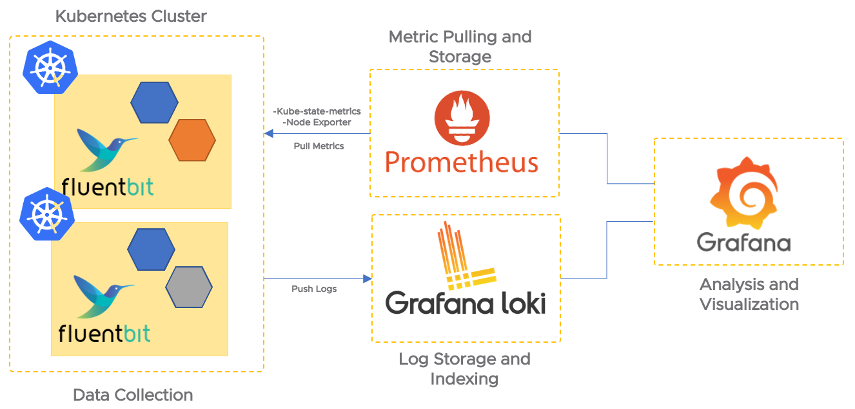
HIGH LEVEL ARCHITECTURE DIAGRAM

Slide 18
CREATE A NAMESPACE
In Kubernetes, it's a best practice to isolate resources by using namespaces. You can create a dedicated namespace for monitoring.
DEPLOY PROMETHEUS
Prometheus is responsible for collecting and storing metrics from your cluster. You can manually deploy it using Kubernetes resources.
Create ConfigMap for Prometheus Configuration: Create a ConfigMap to store your Prometheus configuration. This configuration includes scrape targets, retention settings, and more.
Create Deployment for Prometheus: Deploy Prometheus using a Deployment resource. Specify the Prometheus Docker image, mount the ConfigMap as a volume for the configuration, and expose the necessary ports.
Create a Service for Prometheus: Create a Service resource to expose Prometheus within the cluster. This allows other components to discover and communicate with Prometheus.

Slide 19
Deploy Loki:
Loki is used for log aggregation. Similar to Prometheus, you'll create Kubernetes resources for Loki.
Create ConfigMap for Loki Configuration: Create a ConfigMap to store your Loki configuration. This configuration includes authentication settings, storage settings, and more.
Create Deployment for Loki: Deploy Loki using a Deployment resource. Specify the Loki Docker image, mount the ConfigMap as a volume for configuration, and expose the necessary ports.
Create a Service for Loki: Create a Service resource to expose Loki within the cluster.
Deploy Fluent Bit:
Fluent Bit is responsible for collecting and forwarding logs from your cluster to Loki.
Create ConfigMap for Fluent Bit Configuration: Create a ConfigMap to store your Fluent Bit configuration. This configuration includes log collection settings, outputs to Loki, and more.
Create a DaemonSet for Fluent Bit: Deploy Fluent Bit using a DaemonSet resource. This ensures that Fluent Bit runs on every node in your cluster, collecting logs from pods.

Slide 20
Configure Prometheus and Fluent Bit:
Both Prometheus and Fluent Bit need to be configured to collect and scrape metrics and logs correctly. Ensure that Prometheus is scraping your applications and cluster components, while Fluent Bit is correctly forwarding logs to Loki.
Access Grafana UI:
Grafana is the visualization tool for Prometheus metrics and Loki logs. To access the Grafana UI, you can create a Kubernetes service or use port forwarding:
Create a Service for Grafana: Create a Service resource for Grafana to expose it within the cluster.
Use Port Forwarding: Alternatively, you can use port forwarding to access the Grafana dashboard from your local machine.
Once port forwarding is active, you can access the Grafana UI by opening a web browser and navigating to http://localhost:3000. Log in with the default credentials (admin/admin) and change the password immediately.

Slide 21
Configure Grafana Data sources:
In the Grafana UI, go to "Configuration" -> "Data Sources."
Click "Add data source."
Choose "Prometheus" as the data source type.
Configure the URL for Prometheus (e.g., http://prometheus:9090).
Save and test the data source.
Create Dashboards and Panels in Grafana:
You can create custom dashboards in Grafana to visualize your Prometheus metrics and Loki logs. Grafana provides a user-friendly interface for building and customizing dashboards.
Explore Loki Logs:
In Grafana, you can explore Loki logs by querying and visualizing them on dashboards. Loki allows you to query logs using labels and other criteria.
Remember to customize configurations, security settings, and any additional Grafana dashboard configurations based on your specific requirements and best practices for your cluster environment.

Slide 22
Fluent Bit is not a strict requirement for using Loki, it can be a useful tool in certain log collection scenarios, especially if you need advanced log processing, multi-destination forwarding, or if Fluent Bit is already part of your log management setup. However, you can use Loki effectively with other log collectors like Promtail, and the choice of log collector will depend on your specific requirements and infrastructure.
Fluent Bit is highly configurable and provides various plugins for parsing, filtering, and transforming logs. It can be useful in the following scenarios:
Complex Log Parsing: If you have log sources that produce complex log formats that require custom parsing, Fluent Bit's parsing capabilities can be helpful. You can configure it to extract specific fields or transform log entries before sending them to Loki.
Multi-destination Log Forwarding: Fluent Bit allows you to send logs to multiple destinations simultaneously. For example, you can send logs to both Loki and another log storage system like Elasticsearch, allowing you to maintain redundancy or experiment with different log management tools.
Scaling and Load Balancing: Fluent Bit supports load balancing and can distribute log traffic to multiple Loki instances, helping with scaling and redundancy in larger environments.
Compatibility: If you are already using Fluent Bit as part of your logging infrastructure, you can easily configure it to forward logs to Loki without introducing additional log collectors.

Slide 23

CONCLUSION
The Power of Comprehensive Observability:
In closing, we've embarked on a journey through the realms of modern observability, guided by the triumvirate of Grafana, Loki, and Prometheus. These tools are not just technological solutions; they are enablers of a data-driven culture that empowers organizations to thrive in today's dynamic digital landscape.
Proactive Insights and Action:
Through the lens of this observability stack, we've explored the art of proactive insights and swift action. The ability to detect, diagnose, and address issues before they impact users is not just a technological advantage; it's a strategic imperative.
Visualizing the Unseen:
Grafana has demonstrated its prowess as a visualization powerhouse. With its ability to transform data into visually compelling dashboards, it unveils the unseen patterns, trends, and anomalies in our systems, turning raw data into actionable insights.

Slide 24
Efficient Log Management with Loki:
Loki, our log aggregation hero, has shown us the path to efficient log management. Its label-based indexing, distributed architecture, and real-time log streaming bring simplicity and speed to log querying and analysis.
Prometheus: Guardian of Metrics:
Prometheus, the vigilant guardian of metrics, has illustrated its role in collecting, storing, and alerting on system performance data. Its dynamic querying, native alerting, and ecosystem integration ensure that no metric goes unnoticed.
Unleashing the Trio's Synergy:
As we've seen, these tools aren't mere standalone entities; they are symbiotic. When combined, Grafana, Loki, and Prometheus create a synergy that transcends individual capabilities. The result? A comprehensive observability stack that offers an end-to-end solution for monitoring, centralized logging, and visualization.
Empowering Data-Driven Decisions:
The power of this stack lies not just in its technical prowess, but in its capacity to enable data-driven decisions. It empowers organizations to make informed choices, optimize resources, enhance security, and deliver exceptional user experiences.

